Slide 1
Mini project
blogsite

Slide 2
PREPARED BY
ABDUL AHAD PARWEZ HODEKAR
SHRINIKET KISHOR GAWAS

Slide 3
ABStract
Blogs are a new and intriguing form of communication and personal expression. Researchers are only just beginning to realise the value that these media present as sources of data for research.
This project is created to express the untapped potential that the blogosphere provides for research.
why blogs are a valuable and reliable source of data for analysis , learning new things day to day.

Slide 4
introduction
“Blog” is an abbreviated version of “weblog,” which is a term used to describe websites that maintain an ongoing chronicle of information. A blog features diary-type commentary and links to articles on other websites, usually presented as a list of entries in reverse chronological order. Blogs range from the personal to the political, and can focus on one narrow subject or a whole range of subjects.

Slide 5
Objective
The main objective of the Online Blogging System is to manage the details of Blogs,Topic,Idea,Content,Entries. It manages all the information about Blogs, Views, Entries, Blogs.
For the individuals , their need for information and skill development.

Slide 6
planning
All members from our group decided to work on this project called “BLOGSITE” Because there are many reasons why blogs are important.
It helps people prepare if they need to learn and develop skills.
It helps businesses and people plan for analysing data , markets , etc.
It helps to describe websites that maintain an ongoing chronicle of information.
It helps people learning new things day to day.
So we all gather information about this blogsite project and started to implementing the project using the language HTML, JAVASCRIPT and CSS.

Slide 7
We started by creating a Home page and giving it a base design using a css sheet.
For the next session we created Contact page and similarly created a specific page for article search.
Finally we are working on the About page and at last we are gonna finish by giving a look at how the search and find will work.

Slide 8
Proposed work
The user will have access to various articles , and can be able to learn or know about known/unknown ideas.
Blogs are refreshed every moment, so people can have various interesting articles.
Blog posting is easy to do.
Blog searches are quicker and are very relatable to users expectations.

Slide 9
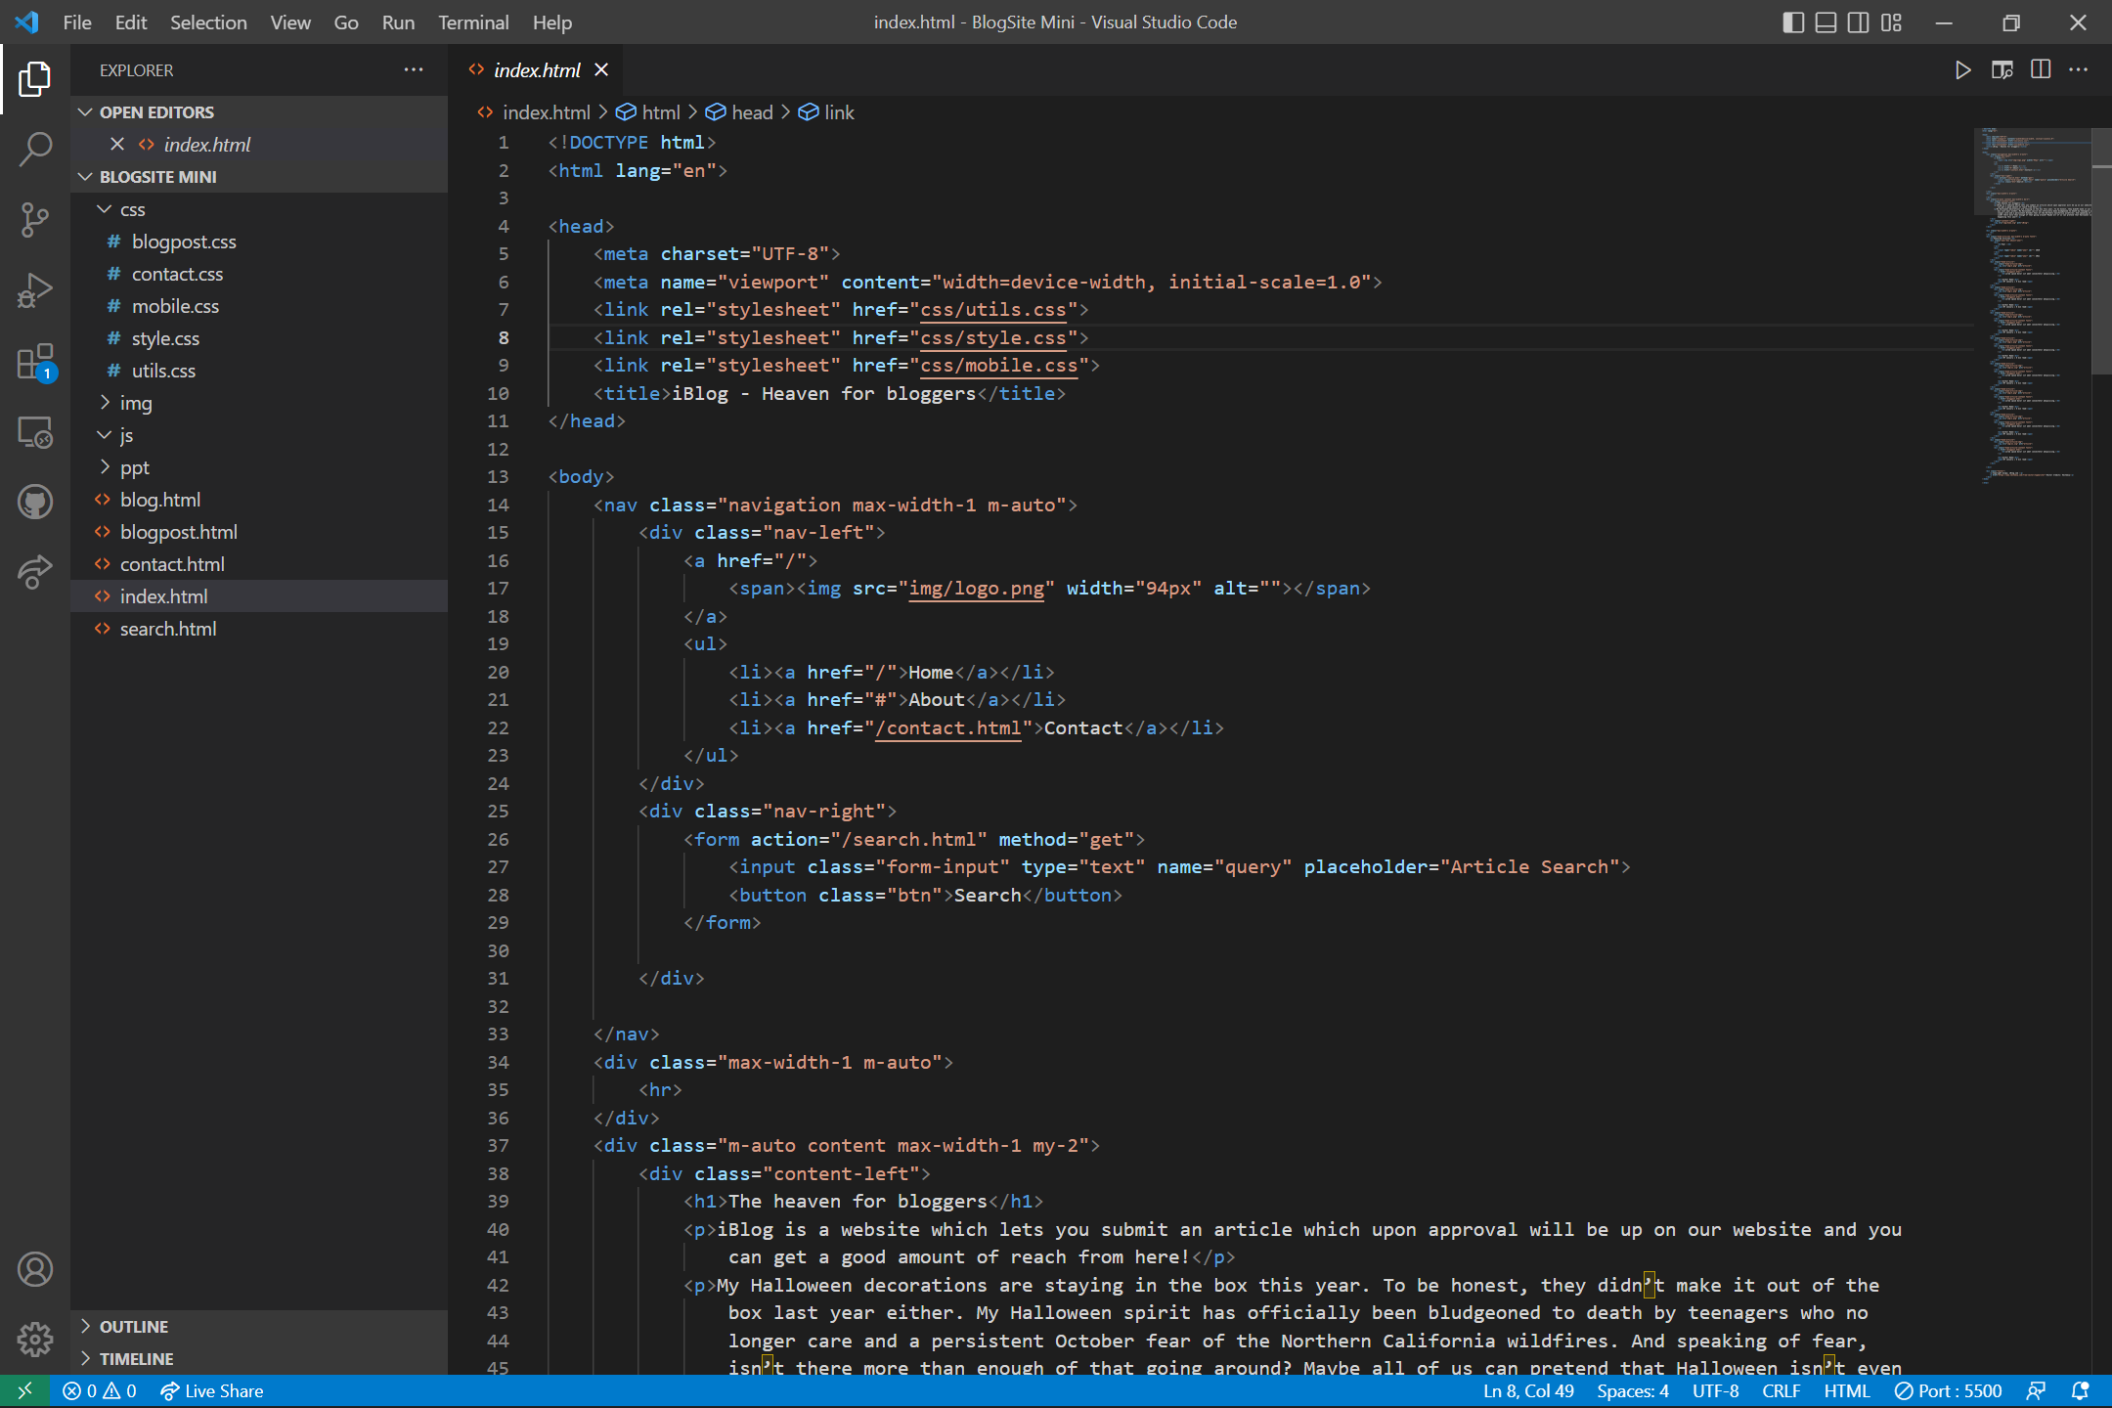
CONTent

Slide 10
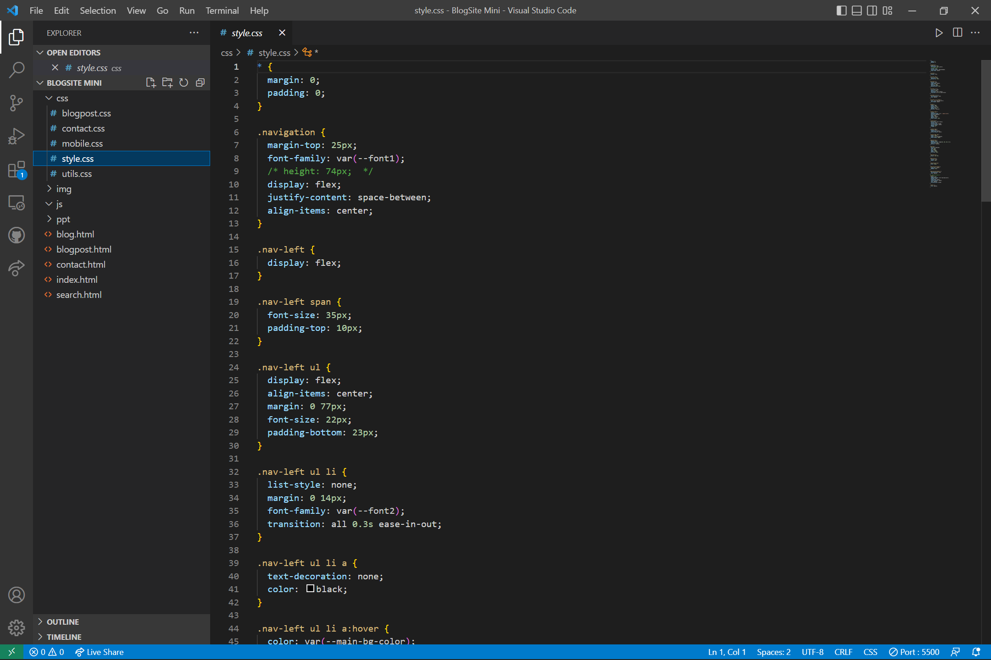

Slide 11
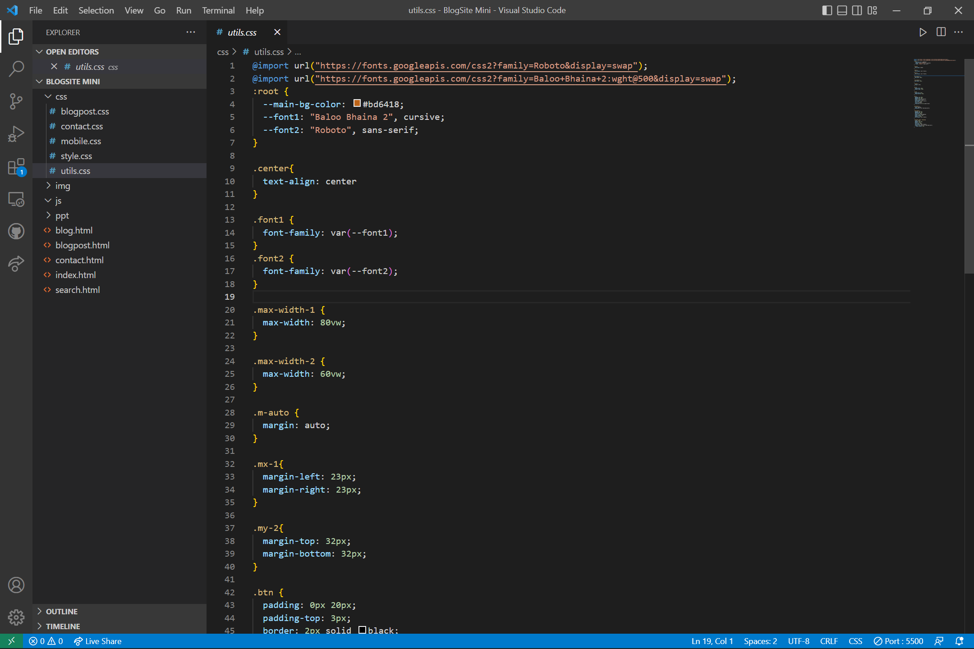

Slide 12
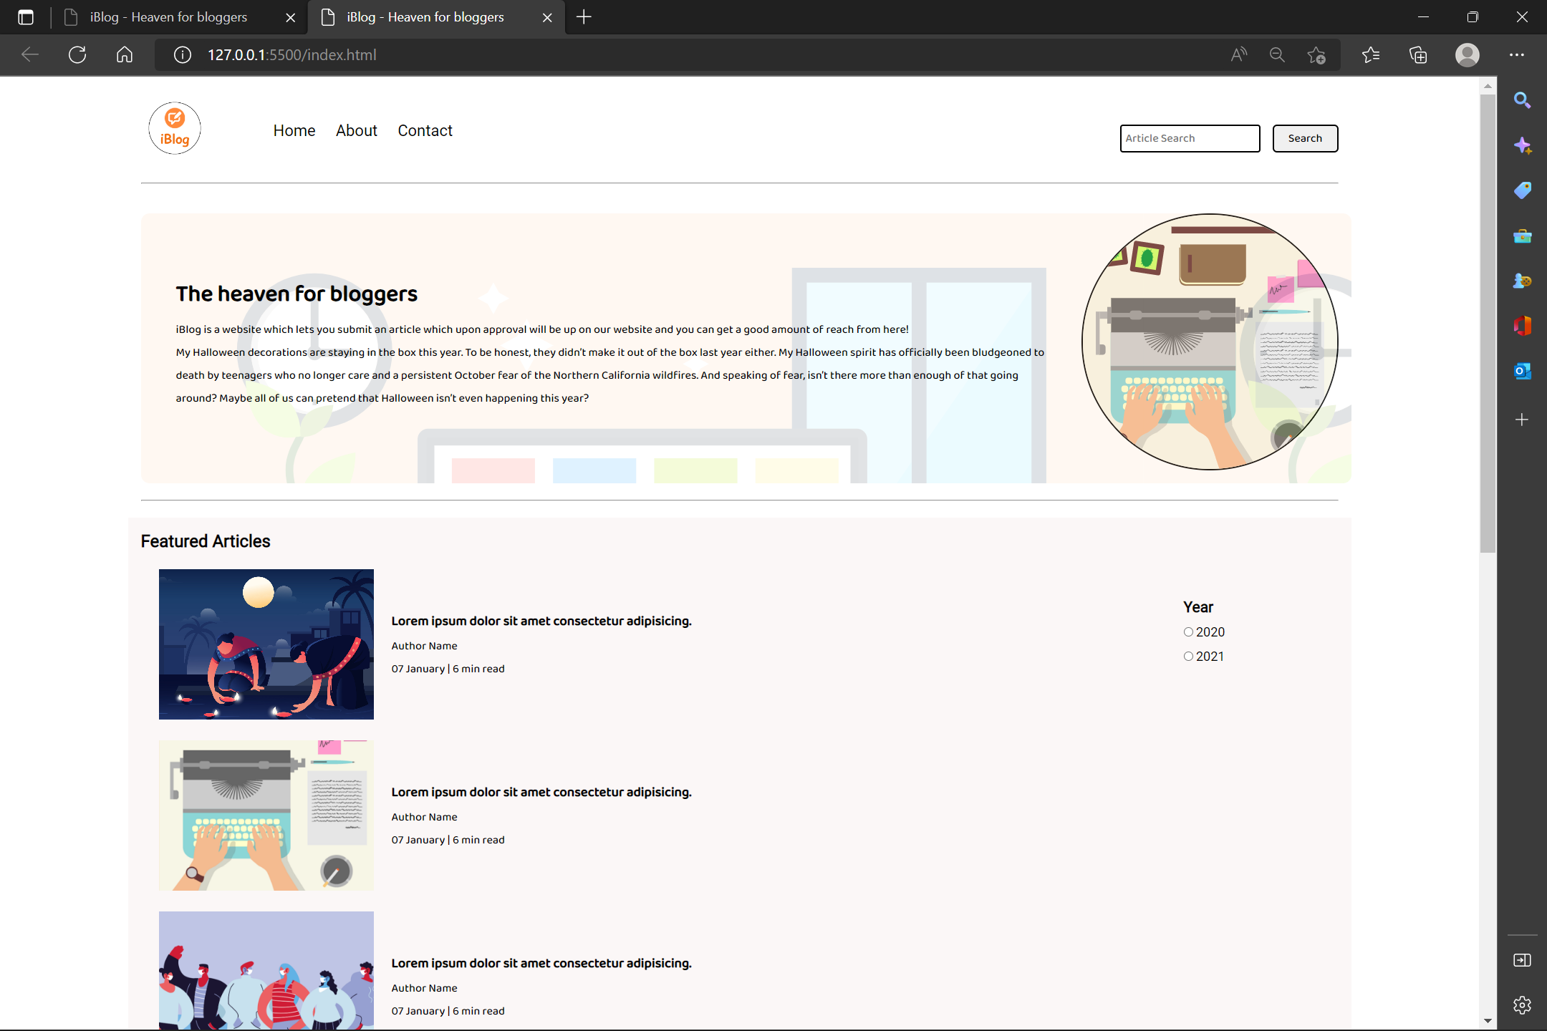
Expected output

Slide 13
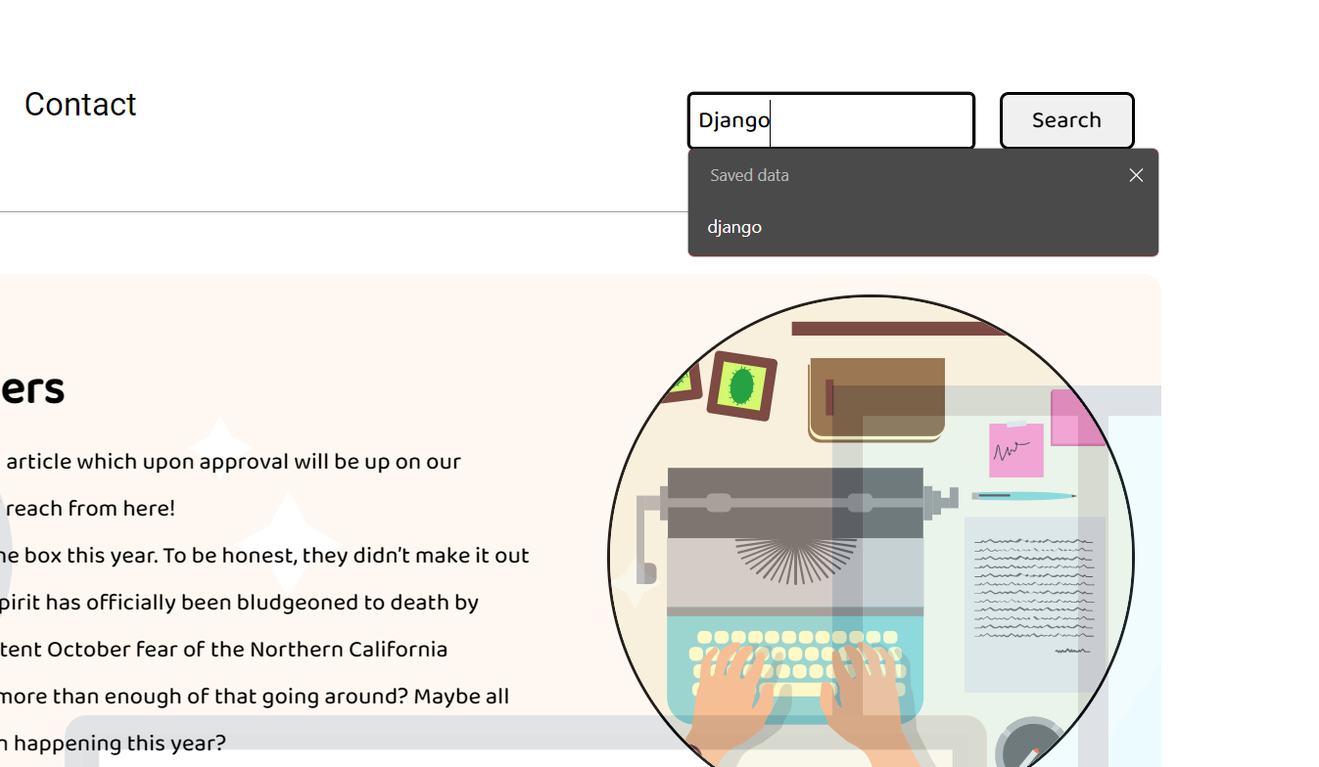

Slide 14
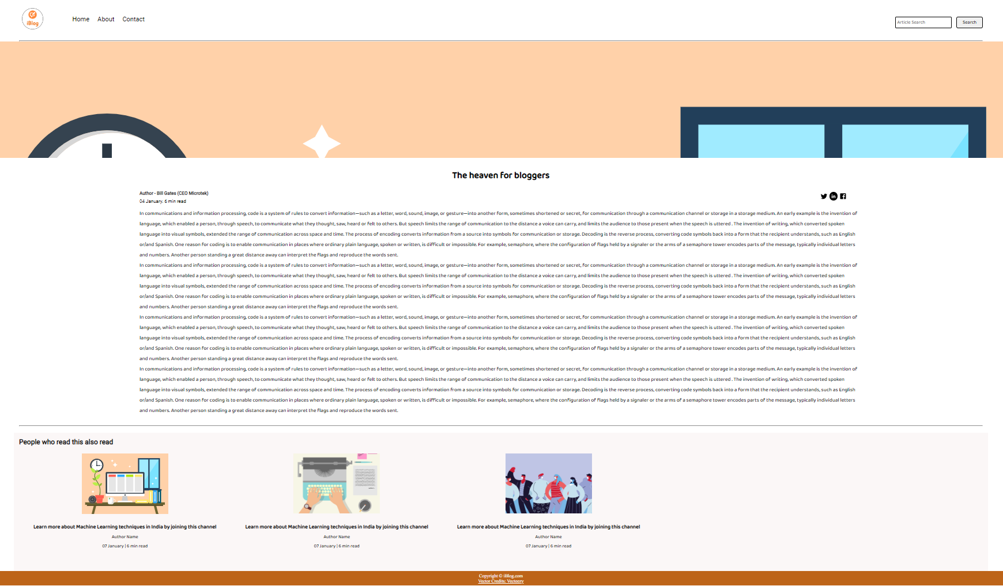

Slide 15
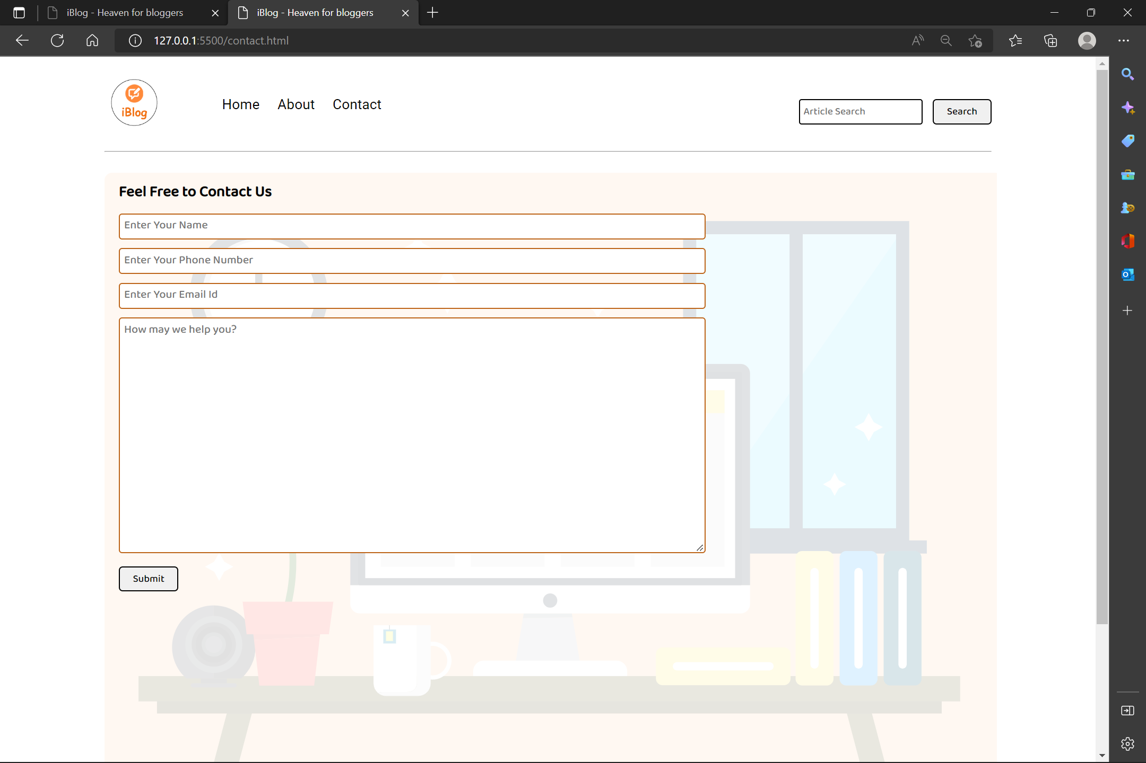

Slide 16
reference
https://code.visualstudio.com/
https://www.youtube.com/
https://www.w3schools.com/

Slide 17
THANK YOU

